Slide 1




EDMS Production Environment Upgrade
EDMS Team
14-08-2012
14, August 2012

Slide 2
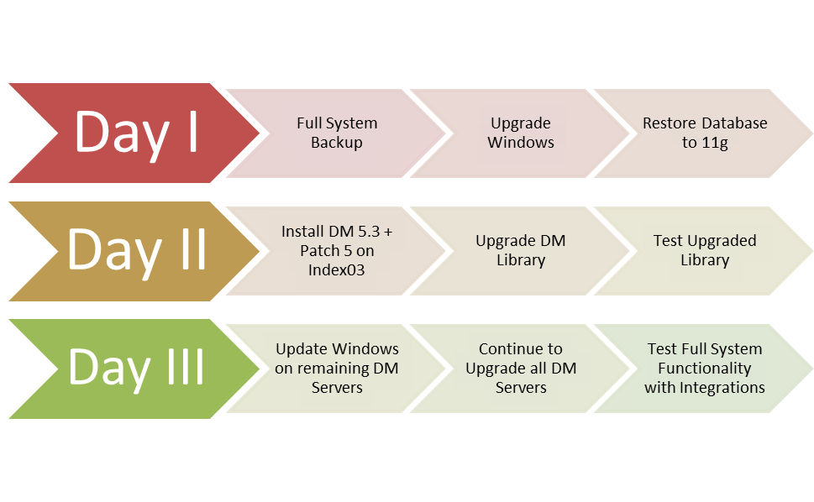

EDMS Production Environment Upgrade Plan

Slide 3
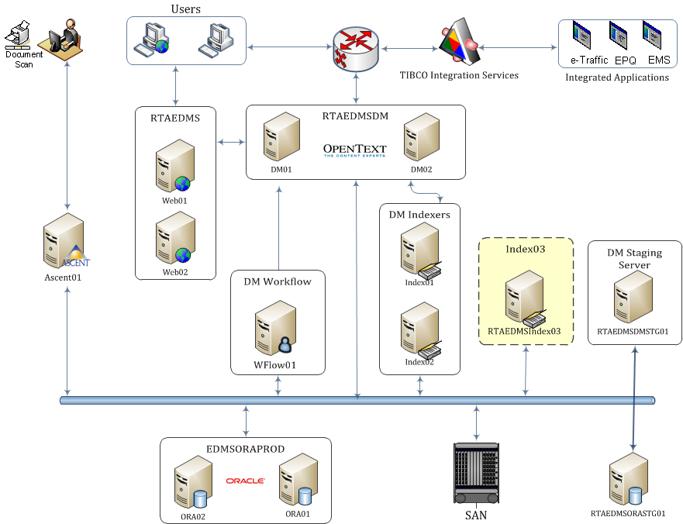
EDMS Production Architecture

Slide 4
Day I
Outage Notification
Step I : Full System Backup
Stop all DM Services on all servers
Backup Database
Full System (Windows) backup (DB Server and DM Servers) with System State, Registry, Installed App, System State including Program Files
Step II: Upgrade Windows
Install Windows Server 2003 SP2
Install .NET Framework 3.5 SP1
Install Visual C++ 2005 SP1
Step III: Connect to newer Database
restore the DB backup to the new database servers
Day I
Full System Backup
Upgrade Windows
Update Database

Slide 5
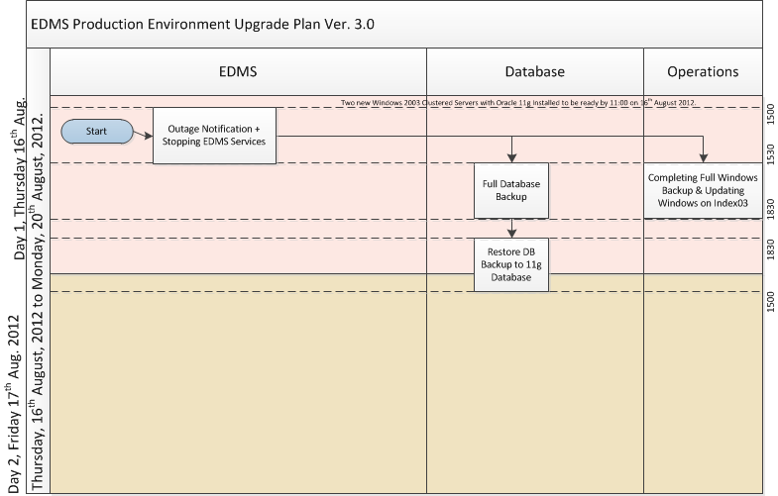
Day I
Day I
Full System Backup
Upgrade EDMSIndex03
Install DM 5.3 &
Upgrade Library

Slide 6
Day II
Step I: Install Index 03 Components
Install DM 5.3 Patch 5
Upgrade DM Library
Configure One Index
Test Upgraded Library (connect client to Index03 test upload sample 10 files, download, search saved searches)
Step II: DM Client Test
Test DM Client
Test all document manipulation commands after upgrading DM Extensions i.e. Add new version, Check out, View, View profile, etc.
Step III: Rollback Procedures
Restore all backups
Day II
Install DM 5.3 + Patch 5
Upgrade DM Library
Test Upgraded Library

Slide 7
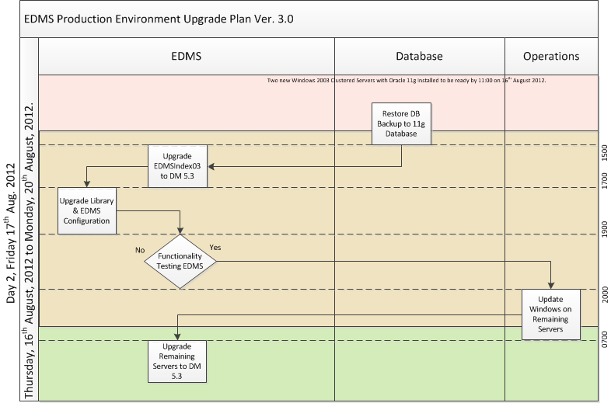
Day II
Day II
Install DM 5.3 + Patch 5
Upgrade DM Library
Test Upgraded Library

Slide 8
Day III
Step I: Upgrade Windows and DM 5.3 on all Remaining Servers
DM01, DM02
Install DM Server 5.3 Patch 5
Index01 , Index02
Delete old Indexes
Install DM Server 5.3 Patch 5, & create new indexes
Web Server
Upgrade Webtop with Patch 5
Install DM 5.3 Patch 5 Extensions Server
Workflow Server
Upgrade Workflow to 5.3 Patch 5
Step II: DM Full Test
Test DM Client (DM Extensions, Webtop)
Test all document manipulation commands after upgrading DM Extensions i.e. Add new version, Search, Check out/in, View, View profile, etc.
Test all Integrated Applications (TIBCO, EMS, EPQ, Backlog Uploader, System Architect Integration)
Troubleshooting issues
Day III
Update Windows on remaining DM Servers
Continue to Upgrade all DM Servers
Test Full System Functionality with Integrations

Slide 9
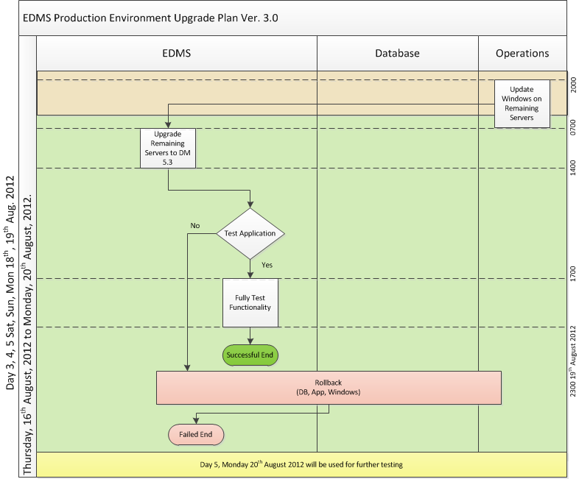
Day III
Day III
Update Windows on remaining DM Servers
Continue to Upgrade all DM Servers
Test Full System Functionality with Integrations

Slide 10

Rollback Procedures
Database Rollback
Database Rollback will require only reconnection to old DB Servers after disconnection from old DB Servers.
Windows Rollback
Rolling back from Windows is by restoring the Windows Backup with System State.
EDMS Index03 Rollback
Rolling back from Index03 5.3 DM Installation will be by Uninstallation of newer version followed by restoration of DM 5.1.0.5 and reconnection to old DB Servers.
EDMS Rollback
Rolling back from 5.3 DM Installation will be by Uninstallation of newer version followed by restoration of DM 5.1.0.5 and reconnection to old DB Servers.

Slide 11
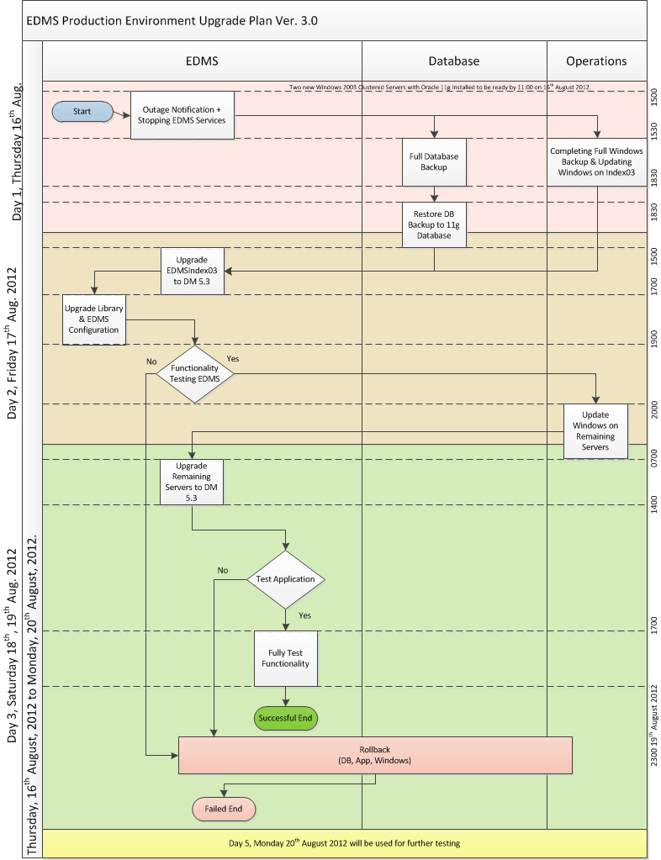
The Big Picture

Slide 12
Risk Mitigation
To avoid the downtime and risks of rolling back, the upgrade plan uses separate servers (RTAEDMSIndex03) and Database Server to keep the running system untouched till upgrade success guaranteed.

Slide 13

THANK YOU

